Slide 1
Tries
adapted from
www.cs.princeton.edu/~rs/AlgsDS07/19Tries.pdf

Slide 2
Abstract data type: Set of Strings
Items: character strings
R = radix = size of the alphabet ∑
W = number of strings (words) in the set
N = total number of characters in all strings in the set
Order: alphabetical
Comparing given search string s with an item takes time O(|s|), not O(1)
Metric: edit distance
Operations
Find, Insert, Delete
Prefix search: find items containing a given string p as prefix
e.g. auto-complete suggestions while typing on a phone
Nearest neighbor: find item/items closest to a given string s
e.g. spell-check
Longest matching prefix: find longest item which is a prefix of given s
e.g. IP forwarding
…

Slide 3
Implementing StringSet
Unsorted List L = length of search string
Ѳ(N) space N = total no. of characters
Find/Delete : O(L W) time W = no. of words
Insert : O(L) time
Sorted Vector
Ѳ(N) space
Find : O(L ∙ log W) time
Insert/Delete : O(W + L ∙ log W) time
Balanced Search Tree
Ѳ(N) space
Find/Insert/Delete: O(L ∙ log W) time Good!
Prefix search: ?
Q. Can we do better?
A. Yes! Use a ‘Trie’. (Next)

Slide 4
Trie
An R-way tree: each node has an array of R links (to children)
i^{th} link corresponds to the i^{th} character of alphabet
Root represents the empty string φ
Node n ≡ the sequence (string) of characters corresponding to links on the path from root to n.
n does not explicitly store the string str(n) it represents
Descendants of n ≡ strings with a common prefix str(n)
Leaves ≡ keys record: (key, value)
Also store values associated with keys
Implementation may associate keys with some (not all) internal nodes too … (Later)

Slide 5
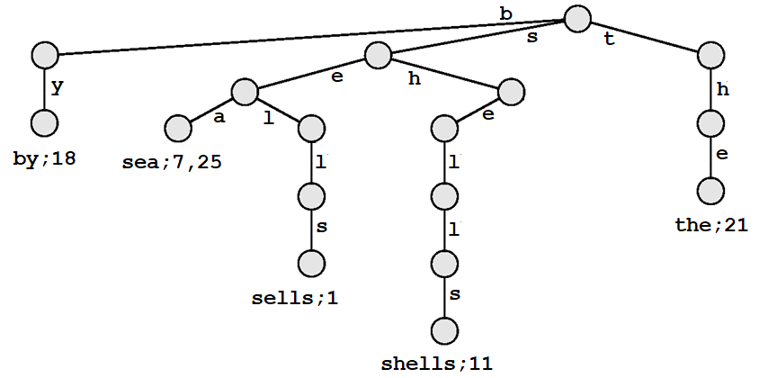
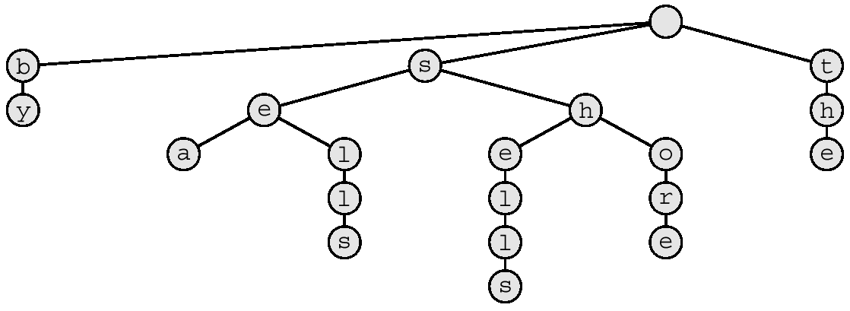
Example: A 26-way Trie
by;18
sea;7,25
the;21
Null pointers not shown
sells;1
shells;11
Every leaf is a key node

Slide 6
Example: A 26-way Trie
by;18
sea;7,25
the;21
Null pointers not shown
sells;1
shells;11
Represents the (searchable) text:
“sells sea shells by the sea”
Position: 1 7 11 18 21 25
Lower-case English alphabet: R = 26
Every leaf is a key node

Slide 7
Applications
Collection of records identified by strings
Directory
key: name, value: phone number
Searchable text document
key: word, value: position in text
Dictionary (auto-complete, spell-check)
key: word, value: frequency of usage
IP forwarding (longest matching prefix)
key: IP address, value: outgoing link
DNA sequencing, Protein sequencing, …

Slide 8
Searching for a key
Characters of string s guide the search for s
e.g. “sells sea shells by the sea”
Position: 1 7 11 18 21 25
by;18
sea;7,25
the;21
sells;1
shells;11

Slide 9
Searching for a key
Characters of string s guide the search for s
e.g. “sells sea shells by the sea” Find “sea”
Position: 1 7 11 18 21 25
by;18
sea;7,25
the;21
sells;1
shells;11

Slide 10
Searching for a key
Characters of string s guide the search for s
e.g. “sells sea shells by the sea” Find “sea”
Position: 1 7 11 18 21 25
by;18
sea;7,25
the;21
sells;1
shells;11

Slide 11
Searching for a key
Characters of string s guide the search for s
e.g. “sells sea shells by the sea” Find “sea”
Position: 1 7 11 18 21 25
by;18
sea;7,25
the;21
sells;1
shells;11

Slide 12
Searching for a key
Characters of string s guide the search for s
e.g. “sells sea shells by the sea” Find “sea”
Position: 1 7 11 18 21 25 Found: at 7, 25
by;18
sea;7,25
the;21
sells;1
shells;11

Slide 13
Searching for a key
Characters of string s guide the search for s
e.g. “sells sea shells by the sea” Find “see”
Position: 1 7 11 18 21 25
by;18
sea;7,25
the;21
sells;1
shells;11

Slide 14
Searching for a key
Characters of string s guide the search for s
e.g. “sells sea shells by the sea” Find “see”
Position: 1 7 11 18 21 25
by;18
sea;7,25
the;21
sells;1
shells;11

Slide 15
Searching for a key
Characters of string s guide the search for s
e.g. “sells sea shells by the sea” Find “see”
Position: 1 7 11 18 21 25
by;18
sea;7,25
the;21
sells;1
shells;11

Slide 16
Searching for a key
Characters of string s guide the search for s
e.g. “sells sea shells by the sea” Find “see”
Position: 1 7 11 18 21 25 Not found
by;18
sea;7,25
the;21
sells;1
shells;11

Slide 17
Searching for a key
Characters of string s guide the search for s
e.g. “sells sea shells by the sea” Find “she”
Position: 1 7 11 18 21 25
by;18
sea;7,25
the;21
sells;1
shells;11

Slide 18
Searching for a key
Characters of string s guide the search for s
e.g. “sells sea shells by the sea” Find “she”
Position: 1 7 11 18 21 25
by;18
sea;7,25
the;21
sells;1
shells;11

Slide 19
Searching for a key
Characters of string s guide the search for s
e.g. “sells sea shells by the sea” Find “she”
Position: 1 7 11 18 21 25
by;18
sea;7,25
the;21
sells;1
shells;11

Slide 20
Searching for a key
Characters of string s guide the search for s
e.g. “sells sea shells by the sea” Find “she”
Position: 1 7 11 18 21 25 Not found
by;18
sea;7,25
the;21
sells;1
shells;11

Slide 21
Inserting a key
Characters of string s guide the search for s
e.g. “sells sea shells by the sea shore”
Position: 1 7 11 18 21 25 29
by;18
sea;7,25
the;21
sells;1
shore;29
shells;11

Slide 22
Inserting a key
Characters of string s guide the search for s
e.g. “sells sea shells by the sea shore”
Position: 1 7 11 18 21 25 29
by;18
sea;7,25
the;21
sells;1
shore;29
shells;11

Slide 23
Inserting a key
Characters of string s guide the search for s
e.g. “sells sea shells by the sea shore”
Position: 1 7 11 18 21 25 29
by;18
sea;7,25
the;21
sells;1
shore;29
shells;11

Slide 24
Inserting a key
Characters of string s guide the search for s
e.g. “sells sea shells by the sea shore”
Position: 1 7 11 18 21 25 29
by;18
sea;7,25
the;21
sells;1
shells;11

Slide 25
Inserting a key
Characters of string s guide the search for s
e.g. “sells sea shells by the sea shore”
Position: 1 7 11 18 21 25 29
by;18
sea;7,25
the;21
sells;1
shells;11

Slide 26
Inserting a key
Characters of string s guide the search for s
e.g. “sells sea shells by the sea shore”
Position: 1 7 11 18 21 25 29
by;18
sea;7,25
the;21
sells;1
shore;29
shells;11

Slide 27
Keys prefixes of other keys
Q. What to do when one key is prefix of another
A1. Append a sentinel ‘\0’ to every key , so it never happens
A2. Store extra valid bit to denote whether the node is a key
e.g. “she sells sea shells by the sea shore”
Internal nodes may need to be key nodes
by
she
sea
the
sells
shore
shells

Slide 28
Keys prefixes of other keys
Q. What to do when one key is prefix of another
A1. Append a sentinel ‘\0’ to every key , so it never happens
A2. Store extra valid bit to denote whether the node is a key
e.g. “she sells sea shells by the sea shore”
Internal nodes can not (and need not) be key nodes
\0
by
\0
\0
\0
sea
she
the
\0
\0
sells
\0
shore
shells

Slide 29
Keys prefixes of other keys
Q. What to do when one key is prefix of another
A1. Append a sentinel ‘\0’ to every key , so it never happens
A2. Store extra valid bit to denote whether the node is a key
e.g. “she sells sea shells by the sea shore”
by
she
sea
the
sells
shore
shells

Slide 30
Keys prefixes of other keys
Q. What to do when one key is prefix of another
A1. Append a sentinel ‘\0’ to every key , so it never happens
A2. Store extra valid bit to denote whether the node is a key
e.g. “she sells sea shells by the sea shore”
Internal nodes too can be key nodes
0
0
0
1
0
0
0
1
0
by
1
0
she
1
sea
0
0
0
the
1
0
1
sells
1
shore
shells

Slide 31
Keys prefixes of other keys
Q. What to do when one key is prefix of another
A1. Append a sentinel ‘\0’ to every key , so it never happens
A2. Store extra valid bit to denote whether the node is a key
e.g. “she sells sea shells by the sea shore”
Internal nodes too can be key nodes
by
she
sea
the
sells
shore
shells

Slide 32
Prefix Search
Find the given prefix string p in the trie
Traverse (in pre-order) the sub-trie T’ rooted at
the last character of p
e.g. “she sells sea shells by the sea shore”
p = “sh”
Output: “she”, “shells”, “shore”

Slide 33
Prefix Search
Find the given prefix string p in the trie
Traverse (in pre-order) the sub-trie T’ rooted at
the last character of p
e.g. “she sells sea shells by the sea shore”
p = “sh”
Output: “she”, “shells”, “shore”
by
she
sea
the
sells
shore
shells

Slide 34
Prefix Search
Find the given prefix string p in the trie
Traverse (in pre-order) the sub-trie T’ rooted at
the last character of p
e.g. “she sells sea shells by the sea shore”
p = “sh”
Output: “she”, “shells”, “shore”
by
she
sea
the
sells
shore
shells

Slide 35
Prefix Search
Find the given prefix string p in the trie
Traverse (in pre-order) the sub-trie T’ rooted at
the last character of p
e.g. “she sells sea shells by the sea shore”
p = “sh”
Output: “she”, “shells”, “shore”
by
she
sea
the
sells
shore
shells

Slide 36
Prefix Search
Find the given prefix string p in the trie
Traverse (in pre-order) the sub-trie T’ rooted at
the last character of p
e.g. “she sells sea shells by the sea shore”
p = “sh”
Output: “she”, “shells”, “shore”
by
she
sea
the
sells
shore
shells

Slide 37
Prefix Search
Find the given prefix string p in the trie
Traverse (in pre-order) the sub-trie T’ rooted at
the last character of p
e.g. “she sells sea shells by the sea shore”
p = “sh”
Output: “she”, “shells”, “shore”
by
she
sea
the
sells
shore
T’
shells

Slide 38
Prefix Search
Find the given prefix string p in the trie
Traverse (in pre-order) the sub-trie T’ rooted at
the last character of p
e.g. “she sells sea shells by the sea shore”
p = “sh”
Output: “she”, “shells”, “shore”
x
by
she
sea
the
sells
shore
T’
shells

Slide 39
Prefix Search
Find the given prefix string p in the trie
Traverse (in pre-order) the sub-trie T’ rooted at
the last character of p
e.g. “she sells sea shells by the sea shore”
p = “sh”
Output: “she”, “shells”, “shore”
x
by
√
she
sea
the
sells
shore
T’
shells

Slide 40
Prefix Search
Find the given prefix string p in the trie
Traverse (in pre-order) the sub-trie T’ rooted at
the last character of p
e.g. “she sells sea shells by the sea shore”
p = “sh”
Output: “she”, “shells”, “shore”
x
by
√
she
sea
x
the
sells
shore
T’
shells

Slide 41
Prefix Search
Find the given prefix string p in the trie
Traverse (in pre-order) the sub-trie T’ rooted at
the last character of p
e.g. “she sells sea shells by the sea shore”
p = “sh”
Output: “she”, “shells”, “shore”
x
by
√
she
sea
x
the
x
sells
shore
T’
shells

Slide 42
Prefix Search
Find the given prefix string p in the trie
Traverse (in pre-order) the sub-trie T’ rooted at
the last character of p
e.g. “she sells sea shells by the sea shore”
p = “sh”
Output: “she”, “shells”, “shore”
x
by
√
she
sea
x
the
x
sells
√
shore
T’
shells

Slide 43
Prefix Search
Find the given prefix string p in the trie
Traverse (in pre-order) the sub-trie T’ rooted at
the last character of p
e.g. “she sells sea shells by the sea shore”
p = “sh”
Output: “she”, “shells”, “shore”
x
by
√
she
x
sea
x
the
x
sells
√
shore
T’
shells

Slide 44
Prefix Search
Find the given prefix string p in the trie
Traverse (in pre-order) the sub-trie T’ rooted at
the last character of p
e.g. “she sells sea shells by the sea shore”
p = “sh”
Output: “she”, “shells”, “shore”
x
by
√
she
x
sea
x
x
the
x
sells
√
shore
T’
shells

Slide 45
Prefix Search
Find the given prefix string p in the trie
Traverse (in pre-order) the sub-trie T’ rooted at
the last character of p
e.g. “she sells sea shells by the sea shore”
p = “sh”
Output: “she”, “shells”, “shore”
x
by
√
she
x
sea
x
x
the
x
√
sells
√
shore
T’
shells

Slide 46
C++ Implementation
struct Node; // forward declaration
class StringSet{
Node* pRoot; // pointer to root
public:
StringSet() { pRoot = NULL; }
bool find(string& s);
void insert(string s);
void delete(string s);
void prefixSearch(string& s);
private:
bool find(string& s, int i);
void insert(string& s, int i);
void delete(string& s, in i);
void prefixSearch(string& s, int i);
}
struct Node{
static int R = 128; // radix
StringSet next[R];
bool isKey;
Node(){ isKey = false; }
}
myset
4-way Trie representing
the string-set
{a, add, bad, cab}
false
a b c d
x
true
false
false
a b c d
a b c d
a b c d
x x x
x x x
x x x
false
false
false
a b c d
a b c d
a b c d
x
x x
x x x
x x x
true
true
true
a b c d
a b c d
a b c d
x x x x
x x x x
x x x x

Slide 47
Finding a Key
bool StringSet::find(string& s){
return find(s, 0);
}
bool StringSet::find(string& s, int i){
if(pRoot == NULL)
return false;
if(s[i] == ‘\0’)
return pRoot->isKey;
return pRoot->next[s[i]].find(s, i+1);
}

Slide 48
Inserting a Key
void StringSet::insert(string s){
insert(s, 0);
}
void StringSet::insert(string& s, int i){
if(pRoot==NULL)
pRoot = new Node();
if(s[i] == ‘\0’)
pRoot->isKey = true;
else
pRoot->next[s[i]].insert(s,i+1);
return;
}

Slide 49
Deleting a Key
void StringSet::delete(string s){ delete(s,0); }
void StringSet::delete(string& s, int i){
if(pRoot == NULL) return;
if(s[i] == ‘\0’) pRoot->isKey = false;
else pRoot->next[s[i]].delete(s,i+1);
bool isLeaf = true; // There are no other strings with s as prefix
for (int j=0; j<R; j++)
if(next[j].pRoot != NULL)
isLeaf = false;
if(isLeaf){
delete pRoot;
pRoot = NULL;
}
return;
}

Slide 50
Prefix Search
void StringSet::prefixSearch(string& s){
// prints, in alphabetical order, all keys with prefix s
prefixSearch(s, 0);
}
void StringSet::prefixSearch(string& s, int i){
if(pRoot == NULL) return;
if(s[i] == ‘\0’){
if(pRoot->isKey)
cout << s << endl;
for(int j=0; j<R; j++)
pRoot->next[j].prefixSearch(s+(char)j, i+1);
}
else pRoot->next[s[i]].prefixSearch(s, i+1);
return;
}

Slide 51
Time taken by operations on R-way Trie
Find: O(L) L = |s|
Hit: need to check every character of search string s : Ѳ(L)
Check one next character: Ѳ(1)
Miss: possibly fewer checks (only a prefix of s) : O(L)
→ Search in sub-linear (average) time!
Insert: O(RL)
Need to check every character of s : Ѳ(L)
Need to add every character not already present : O(RL)
Add one next character: Ѳ(R)
Delete: O(RL)
Find string s : O(L)
(iteratively) remove last character if it is a leaf : O(RL)
Check R links to verify if a node is leaf : O(R)
Prefix search: O(RN) N = #(nodes in trie) ≤ #(chars. in set)
Find the prefix string p : O(L) L = |p|
Traverse the sub-trie T’ rooted at the last character of p : Ѳ(R∙|T’|)

Slide 52
Space used by R-way Trie
O(RN) space N = #(nodes in trie) ≤ #(chars. in set)
R links at each node (character)
Method of choice for small R
e.g. case-insensitive English alphabet: R=26
Applications: auto-complete, spell-check
128-way branching for ASCII : costly
65536-way branching for Unicode : impractical
Many links empty at nodes, all at leaves
Need to address space wastage (Next)

Slide 53
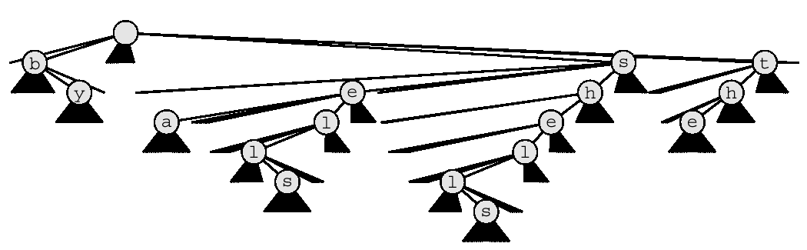
Trie: too many empty links
Q. How to branch to next level?
One link (pointer) for each possible character
.
e.g. “she sells sea shells by the sea”
26-way Trie
26 empty links on leaf

Slide 54
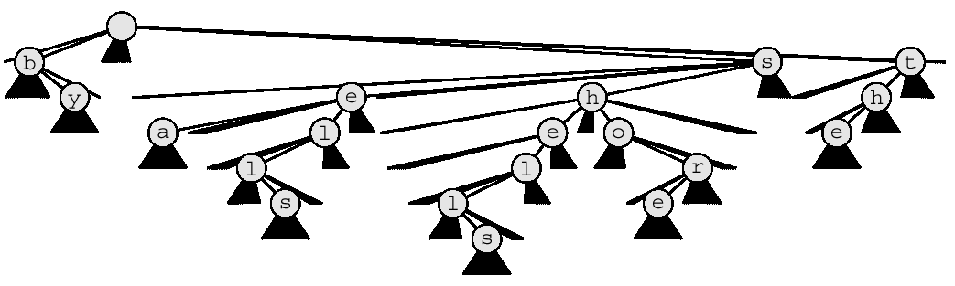
Trie: too many empty links
New record adds some chars, many empty links
How to use space better? (Next)
.
e.g. “she sells sea shells by the sea shore”

Slide 55
Ternary Search Trie (TST)
In every node of R-way trie:
Replace the array (of R pointers) by a BST
→ Ternary Search Trie: each node has
a character c
a boolean isKey to indicate whether this node represents (the last character of) some key
three child pointers:
left : search for s[i] < c
middle : s[i] = c found; now search for s[i+1]
right : search for s[i] > c

Slide 56
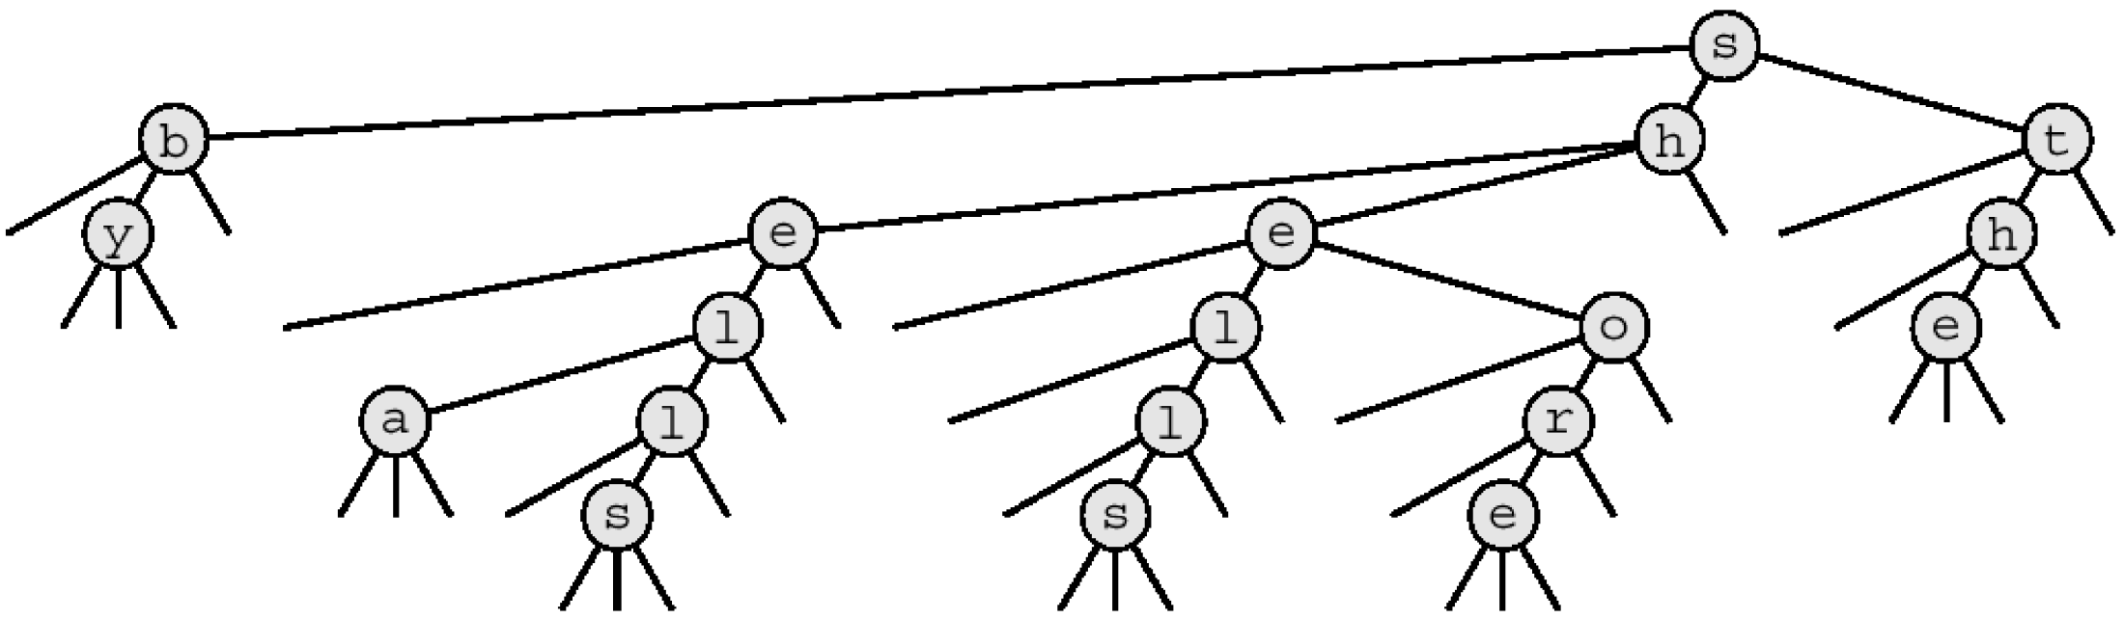
Ternary Search Trie (TST)
left : search for s[i] < c
middle : s[i] = c found; now search for s[i+1]
right : search for s[i] > c
e.g. she “sells sea shells by the sea” shore
Only 3 empty null pointers in leaf, fewer in non-leaf nodes

Slide 57
Ternary Search Trie (TST)
left : search for s[i] < c
middle : s[i] = c found; now search for s[i+1]
right : search for s[i] > c
e.g. “she sells sea shells by the sea” shore
Only 3 empty null pointers in leaf, fewer in non-leaf nodes

Slide 58
Ternary Search Trie (TST)
left : search for s[i] < c
middle : s[i] = c found; now search for s[i+1]
right : search for s[i] > c
e.g. “she sells sea shells by the sea shore”
Only 3 empty null pointers in leaf, fewer in non-leaf nodes

Slide 59
Ternary Search Trie (TST)
left : search for s[i] < c
middle : s[i] = c found; now search for s[i+1]
right : search for s[i] > c
e.g. “she sells sea shells by the sea shore”
Only 3 empty null pointers in leaf, fewer in non-leaf nodes

Slide 60
Ternary Search Trie (TST)
left : search for s[i] < c
middle : s[i] = c found; now search for s[i+1]
right : search for s[i] > c
e.g. “she sells sea shells by the sea shore”
Only 3 empty null pointers in leaf, fewer in non-leaf nodes

Slide 61
Ternary Search Trie (TST)
left : search for s[i] < c
middle : s[i] = c found; now search for s[i+1]
right : search for s[i] > c
e.g. “she sells sea shells by the sea shore”
Only 3 empty null pointers in leaf, fewer in non-leaf nodes

Slide 62
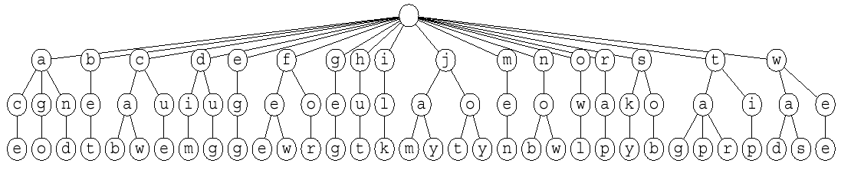
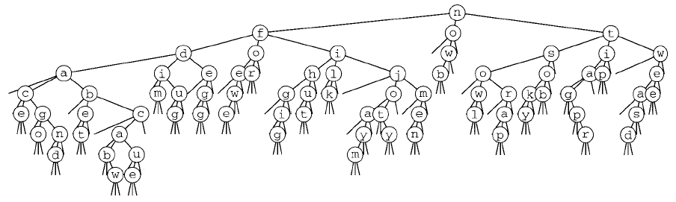
Example: 26-way Trie vs. TST
now
for
tip
ilk
dim
tag
jot
sob
nob
sky
hut
ace
bet
men
egg
few
jay
owl
joy
rap
gig
wee
was
cab
wad
caw
cue
fee
tap
ago
tar
jam
dug
and
26-way Trie
26-17 + 17*26-26 + 26*26-34 + 34*26 = 1951 null pointers
(not shown)
TST
155 null pointers

Slide 63
TST: C++ Implementation
struct Node; // forward declaration
class StringSet{
Node* pRoot; // pointer to root
public:
StringSet() { pRoot = NULL; }
bool find(string& s);
void insert(string s);
void delete(string s);
private:
bool find(string& s, int i);
void insert(string& s, int i);
void delete(string& s, in i);
}
struct Node{
char c;
bool isKey;
StringSet left, mid, right;
Node(char ch){
c = ch;
isKey = false;
}
}
{bad, a, add, ada, cad, cab}
myset
b
F
a
T
a
F
c
F
x x
x x
x x
d
F
d
T
a
F
x x
x x x
x x
d
T
d
T
x x
x x
a
T
b
T
x x x
x x x

Slide 64
TST: finding a string
bool StringSet::find(string& s){
return find(s, 0);
}
bool StringSet::find(string& s, int i){
if(pRoot == NULL)
return false;
if(s[i] < pRoot->c)
retrun pRoot->left.find(s, i);
else if(s[i] > pRoot->c)
retrun pRoot->right.find(s, i);
else{
if(s[++i] == ‘\0’)
return pRoot->isKey;
return pRoot->mid.find(s, i);
}
}

Slide 65
TST: inserting a string
void StringSet::insert(string s){
return insert(s, 0);
}
void StringSet::insert(string& s, int i){
if(pRoot == NULL)
pRoot = new Node(s[i]);
if (s[i] == pRoot->c){
if(s[++i] ==‘\0’)
pRoot->isKey = true;
else
pRoot->mid.insert(s, i);
}
else if(s[i] < pRoot->c)
pRoot->left.insert(s, i);
else
pRoot->right.insert(s, i);
return;
}

Slide 66
TST: deleting a string
void StringSet::delete(string s){ delete(s,0); }
void StringSet::delete(string& s, int i){
if(pRoot == NULL)
return;
if(s[i] < pRoot->c)
retrun pRoot->left.delete(s, i);
else if(s[i] > pRoot->c)
retrun pRoot->right.delete(s, i);
else{
if(s[++i] == ‘\0’)
pRoot->isKey = false;
else
pRoot->mid.delete(s, i);
}
Node* p = pRoot;
if(p->l==NULL && p->m==NULL && p->r==NULL && !p->isKey){
delete pRoot;
pRoot = NULL;
}
return;
}

Slide 67
TST Performance
Space: O(N)
Only 3 links at each node (character)
Average Time (also worst case time if we use Balanced, instead of Binary ST):
Find: O(L log R) L = |s|
Hit: need to check every character of search string s : Ѳ(L) ∙ O(log R)
Check one next character: O(log R)
Miss: possibly fewer checks (only a prefix of s) : O(L) ∙ O(log R)
Insert: O(L log R)
Check every character already present: O(L) ∙ O(log R)
Add every character not already present : O(L)
Add one next character: O(1)
Delete: O(L log R)
Find string s : O(L log R)
Mark as `not a key’ : O(1)
(iteratively) remove last character if it is a leaf : O(L)
Delete one character: O(1)
Prefix search: O(N) N = #(nodes in TST) ≤ #(chars. in set)
Find the prefix string p : O(L log R) L = |p|
Traverse the sub-trie T’ rooted at the last character of p : Ѳ(|T’|)

